Slide 1

Alpha Decay
Alpha Decay A nucleus emitting an alpha particle loses two protons and two neutrons.
Therefore, the atomic number Z decreases by 2, the mass number A decreases by 4, and the neutron number decreases by 2.
The decay can be written
where X is called the parent nucleus and Y the daughter nucleus.

Slide 2

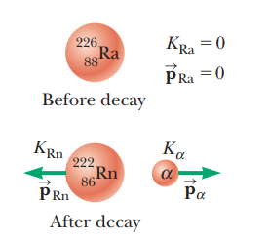
Alpha Decay
As a general rule in any decay expression such as this one,
(1) the sum of the mass numbers A must be the same on both sides of the decay and
(2) the sum of the atomic numbers Z must be the same on both sides of the decay.
As examples, ²³⁸U and ²²⁶Ra are both alpha emitters and decay according to the schemes
The decay of ²²⁶Ra is shown in Figure.
When the nucleus of one element changes into the nucleus of another as happens in alpha decay, the process is called spontaneous decay

Slide 3

Beta Decay
When a radioactive nucleus undergoes beta decay, the daughter nucleus contains the same number of nucleons as the parent nucleus but the atomic number is changed by 1, which means that the number of protons changes:
where,
e- designates an electron and
e+ designates a positron, with beta particle being the general term referring to either.
Beta decay is not described completely by these expressions.

Slide 4

Beta Decay
As with alpha decay, the nucleon number and total charge are both conserved in beta decays.
Because A does not change but Z does, we conclude that in beta decay, either a neutron changes to a proton or a proton changes to a neutron.
Note that the electron or positron emitted in these decays is not present beforehand in the nucleus; it is created in the process of the decay from the rest energy of the decaying nucleus.
Two typical beta-decay processes are

Slide 5
Beta Decay
The neutrino has the following properties:
It has zero electric charge.
Its mass is either zero (in which case it travels at the speed of light) or very small; much recent persuasive experimental evidence suggests that the neutrino mass is not zero.
It has a spin of 0.5 , which allows the law of conservation of angular momentum to be satisfied in beta decay.
It interacts very weakly with matter and is therefore very difficult to detect.

Slide 6
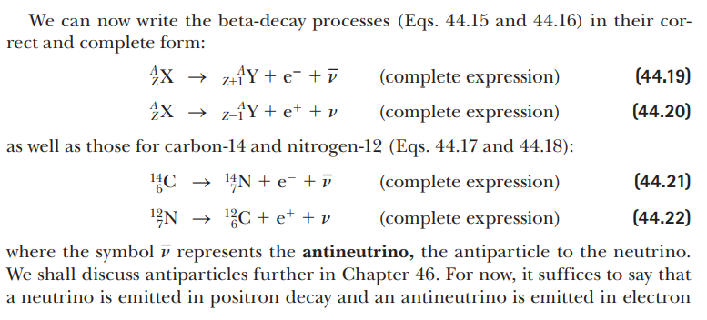

Slide 7
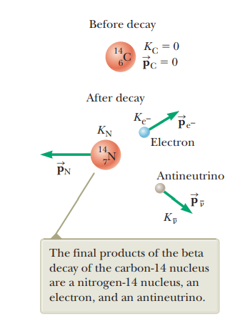
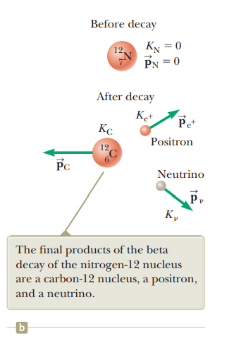

Slide 8

Gamma Decay
Very often, a nucleus that undergoes radioactive decay is left in an excited energy state.
The nucleus can then undergo a second decay to a lower-energy state, perhaps to the ground state, by emitting a high-energy photon:
where X* indicates a nucleus in an excited state.
Photons emitted in such a de-excitation process are called gamma rays.
Such photons have very high energy (1 MeV to 1 GeV) relative to the energy of visible light (approximately 1 eV).

Slide 9

Gamma Decay
A nucleus may reach an excited state as the result of a violent collision with another particle.
More common, however, is for a nucleus to be in an excited state after it has undergone alpha or beta decay.
The following sequence of events represents a typical situation in which gamma decay occurs:

Slide 10
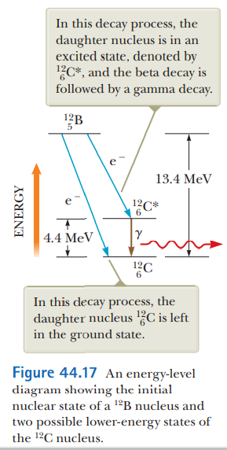
Figure 44.17 shows the decay scheme for ¹²B, which undergoes beta decay to either of two levels of ¹²C.
It can either
(1) decay directly to the ground state of ¹²C by emitting a 13.4-MeV electron or
(2) undergo beta decay to an excited state of ¹²C* followed by gamma decay to the ground state.
The latter process results in the emission of a 9.0-MeV electron and a 4.4-MeV photon.

Slide 12
What are alpha particles?
Alpha particles (a) are composite particles consisting of two protons and two neutrons tightly bound together.
They are emitted from the nucleus of some radionuclides during a form of radioactive decay, called alpha-decay.
An alpha-particle is identical to the nucleus of a normal (atomic mass four) helium atom i.e. a doubly ionised helium atom.
Alpha particles (also termed alpha radiation or alpha rays) was the first nuclear radiation to be discovered, beta particles and gamma rays were identified soon after.

Slide 13
What are the properties of alpha particles?
Alpha particles are relatively slow and heavy compared with other forms of nuclear radiation.
The particles travel at 5 to 7 % of the speed of light or 20,000,000 metres per second
and has a mass approximately equivalent to 4 protons.
Alpha particles, because they are highly ionising, are unable to penetrate very far through matter and are brought to rest by a few centimetres of air or less than a tenth of a millimetre of biological tissue.

Slide 14
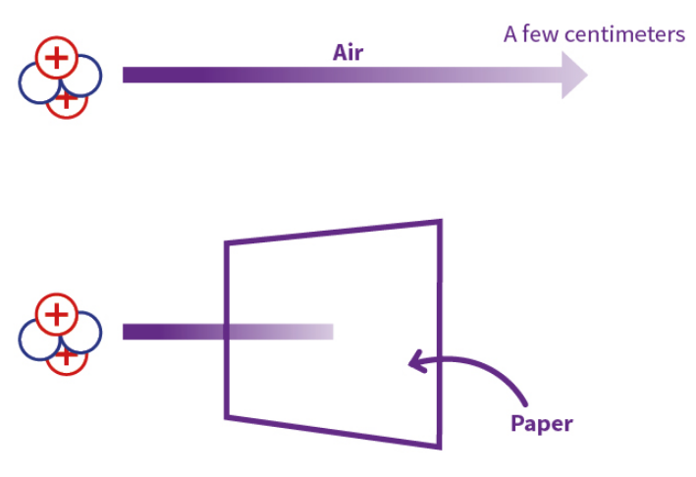
What are the properties of alpha particles?
Alpha particles, because they are highly ionising, are unable to penetrate very far through matter and are brought to rest by a few centimetres of air or less than a tenth of a millimetre of biological tissue.

Slide 15
What are the health effects of exposure to alpha particles?
Alpha particles are highly ionising because of their double positive charge, large mass (compared to a beta particle) and because they are relatively slow.
They can cause multiple ionisations within a very small distance.
This gives them the potential to do much more biological damage for the same amount of deposited energy.

Slide 16
What are the health effects of exposure to alpha particles?
Alpha particles can't penetrate the normal layer of dead cells on the outside of our skin but can damage the cornea of the eye.
Alpha-particle radiation is normally only a safety concern if the radioactive decay occurs from an atom that is already inside the body or a cell.
Alpha-particle emitters are particularly dangerous if inhaled, ingested, or if they enter a wound.

Slide 17
What are some common sources of alpha particles?
Many alpha emitters occur naturally in the environment.
For example, alpha particles are given off by radionuclides such as uranium-238, radium-226, and other members of the naturally occurring uranium, thorium and actinium decay series which are present in varying amounts in nearly all rocks, soils, and water.
Artificially produced sources of alpha particles include the radioisotopes of elements such as plutonium, americium, curium and californium.
These are generally produced in a nuclear reactor through the absorption of neutrons by various uranium radioisotopes.

Slide 18
What are some uses of alpha particles?
Alpha particles have low penetrating power but this still provides a range of useful applications: smoke detectors – americium-241 is commonly used in ionising smoke detectors.
Smoke that enters the detector reduces the amount of alpha particles that are detected and triggers the alarm
static eliminators typically use alpha particles from polonium-210 to remove static charges from equipment

Slide 19
What are some uses of alpha particles?
radioisotope thermoelectric generators use alpha particle decay from plutonium-238 to generate heat which is converted to electricity, commonly used in space probes
some alpha emitters are being investigated for their potential use in unsealed source radiotherapy to treat cancer.

Slide 20
What are beta particles?
Beta particles (β) are high energy, high speed electrons (β⁻) or positrons (β⁺) that are ejected from the nucleus by some radionuclides during a form of radioactive decay called beta-decay.
Beta-decay normally occurs in nuclei that have too many neutrons to achieve stability.

Slide 21
What are the properties of beta particles?
Beta particles have a mass which is half of one thousandth of the mass of a proton and carry either a single negative (electron) or positive (positron) charge.
As they have a small mass and can be released with high energy, they can reach relativistic speeds (close to the speed of light).
Their light mass means that they lose energy quickly through interaction with matter and have a haphazard path as they move through air or other materials.

Slide 22
What are the properties of beta particles?
Beta particles are much less ionising than alpha particles and generally do less damage for a given amount of energy deposition.
They typically have ranges of tens of centimetres in air (energy dependent) and a few millimetres in materials.

Slide 23
What causes some radionuclides to emit beta particles?
Beta minus particle (β⁻) emission occurs when the ratio of neutrons to protons in the nucleus is too high.
An excess neutron transforms into a proton and an electron.

Slide 24
What causes some radionuclides to emit beta particles?
The proton stays in the nucleus and the electron is ejected energetically.
This process decreases the number of neutrons by one and increases the number of protons by one.
Since the number of protons in the nucleus of an atom determines the element, the conversion of a neutron to a proton actually changes the radionuclide to a different element.

Slide 25
What causes some radionuclides to emit beta particles?
Often, gamma ray emission accompanies the emission of a beta particle.
When the beta particle ejection doesn't rid the nucleus of the extra energy, the nucleus releases the remaining excess energy in the form of a gamma photon.

Slide 26
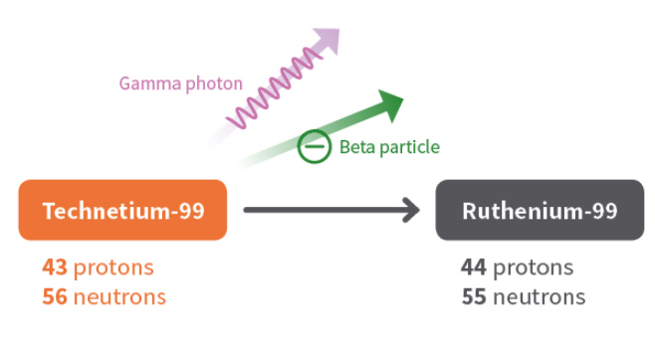
What causes some radionuclides to emit beta particles?
The decay of technetium-99, which has too many neutrons to be stable, is an example of beta decay.
A neutron in the nucleus converts to a proton and a beta particle.
The nucleus ejects the beta particle and some gamma radiation.
The new atom retains the same mass number, but the number of protons increases to 44.
The atom is now a ruthenium atom.

Slide 27
What are the health effects of exposure to beta particles?
Beta-particles, being less ionising than alpha-particles, can travel through many centimetres or even metres or air and through millimetres of skin or tissue.
Sufficient intensity of beta-radiation can cause burns, rather like severe sunburn.
If beta-emitting radionuclides are inhaled or ingested, they can also do damage to internal cells and organs.

Slide 28
What are some common sources of beta particles?
Many beta emitters occur naturally in the radioisotopes found in the natural radioactive decay chains of uranium, thorium and actinium.
Examples include lead-210, bismuth-214 and thallium-206.
Beta emitters are also commonly found in the radioactive products of nuclear fission.
Examples include strontium-90, caesium-137 and tritium.

Slide 29
What are some uses of beta particles?
The medium penetrating power of beta particles provides a range of useful applications which include:
thickness detectors for the quality control of thin materials i.e. paper
treatment of eye and bone cancers, strontium-90 or strontium-89 are commonly used
Fluorine-18 is commonly used as a tracer for positron emission tomography (PET).

Slide 30
What are gamma rays?
A gamma ray (g) is a packet of electromagnetic energy (photon) emitted by the nucleus of some radionuclides following radioactive decay.
Gamma photons are the most energetic photons in the electromagnetic spectrum.

Slide 31
What are the properties of gamma rays?
Gamma rays are a form of electromagnetic radiation (EMR).
They are the similar to X-rays, distinguished only by the fact that they are emitted from an excited nucleus.
Electromagnetic radiation can be described in terms of a stream of photons, which are massless particles each travelling in a wave-like pattern and moving at the speed of light.
Each photon contains a certain amount (or bundle) of energy, and all electromagnetic radiation consists of these photons.
Gamma-ray photons have the highest energy in the EMR spectrum and their waves have the shortest wavelength.
.

Slide 32
What are the properties of gamma rays?
Scientists measure the energy of photons in electron volts (eV).
X-ray photons have energies in the range 100 eV to 100,000 eV (or 100 keV).
Gamma-ray photons generally have energies greater than 100 keV.

Slide 33
What are the properties of gamma rays?
For comparison, ultraviolet radiation has energy that falls in the range from a few electron volts to about 100 eV and does not have enough energy to be classified as ionising radiation.
The high energy of gamma rays enables them to pass through many kinds of materials, including human tissue.
Very dense materials, such as lead, are commonly used as shielding to slow or stop gamma rays.

Slide 34
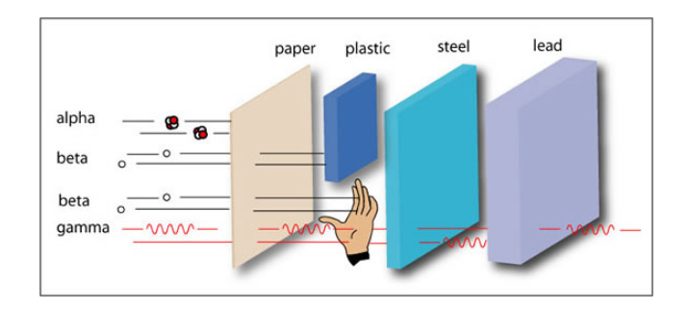

Slide 35
What is the difference between gamma rays and X-rays?
The key difference between gamma rays and X-rays is how they are produced.
Gamma rays originate from the settling process of an excited nucleus of a radionuclide after it undergoes radioactive decay
whereas X-rays are produced when electrons strike a target or when electrons rearrange within an atom.
Cosmic rays also include high-energy photons and these are also called gamma-rays whether or not they originated from nuclear decay or reaction.

Slide 36
What are the health effects of exposure to gamma radiation?
Gamma radiation is highly penetrating and interacts with matter through ionisation via three processes; photoelectric effect, Compton scattering or pair production.
Due to their high penetration power, the impact of gamma radiation can occur throughout a body, they are however less ionising than alpha particles.
Gamma radiation is considered an external hazard with regards to radiation protection.

Slide 37
What are the health effects of exposure to gamma radiation?
Similar to all exposure to ionising radiation, high exposures can cause direct acute effects through immediate damage to cells.
Low levels of exposure carry a stochastic health risk where the probability of cancer induction rises with increased exposure.

Slide 38
What are some common sources of gamma radiation?
Gamma radiation is released from many of the radioisotopes found in the natural radiation decay series of uranium, thorium and actinium as well as being emitted by the naturally occurring radioisotopes potassium-40 and carbon-14.
These are found in all rocks and soil and even in our food and water.
Artificial sources of gamma radiation are produced in fission in nuclear reactors, high energy physics experiments, nuclear explosions and accidents.

Slide 39
What are some uses of gamma ray emitters?
Gamma emitting radionuclides are the most widely used radiation sources.
The penetrating power of gamma rays has many applications.
However, while gamma rays penetrate many materials, this does not make them radioactive.
The three radionuclides that are by far the most useful are cobalt-60, caesium-137, technetium-99m and americium-241.

Slide 40
What are some uses of gamma ray emitters?
Uses of cobalt-60:
sterilisation of medical equipment in hospitals pasteurisation, via irradiation, of certain foodstuffs levelling or thickness gauges (i.e. food packaging, steel mills) industrial radiography.

Slide 41
What are some uses of gamma ray emitters?
Uses of caesium-137:
measurement and control of the flow of liquids in industrial processes investigation of subterranean strata (i.e. oil, coal, gas and other mineralisation) measurement of soil moisture-density at construction sites levelling gauges for packaging of food, drugs and other products.

Slide 42
What are some uses of gamma ray emitters?
Uses of technetium-99m:
Tc-99m is the most widely used radioactive isotope for medical diagnostic studies different chemical forms are used for brain, bone, liver, spleen and kidney imaging.
It is also used for blood flow studies.

Slide 43
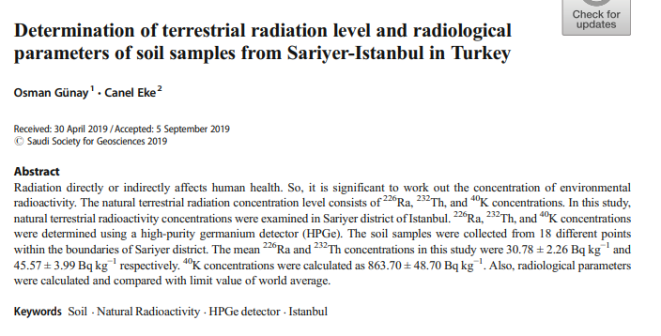

Slide 44


Slide 45
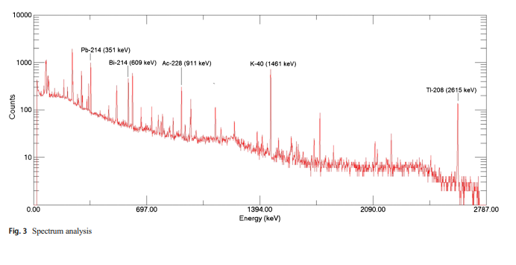

Slide 46
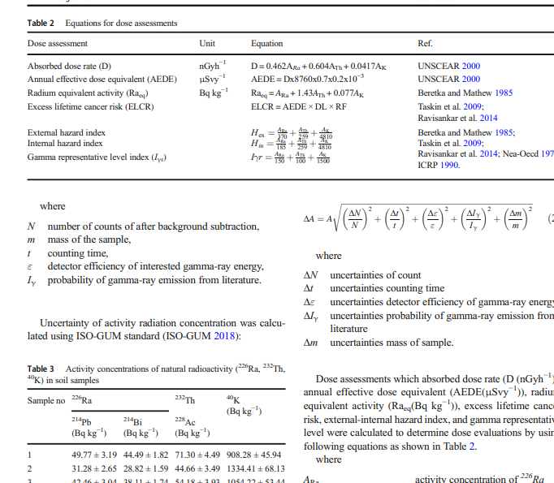

Slide 47
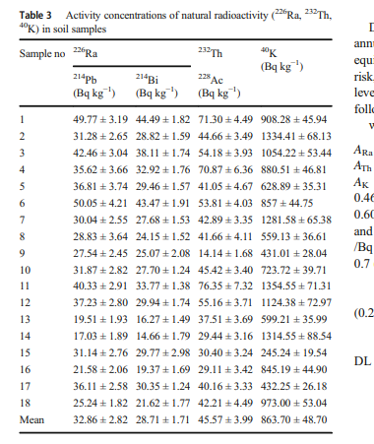

Slide 48


